Slide 1
How the best win
Jon Williams CPP APMP Fellow FRSA MISM
Managing Director, Strategic Proposals
© Strategic Proposals 2018
Notes:
A presentation to APMP’s Bid & Proposal Con in San Diego in May 2018, looking at what makes for proposal success – and at the link between proposal capabilities and win rates.
Delivered by Jon Williams. Jon’s Managing Director of the UK branch of Strategic Proposals – the leading training and consultancy organisation, with operations worldwide. He’s a Fellow of APMP and the Royal Society of Arts, and a Master Member of the Institute of Sales Management.

Slide 2
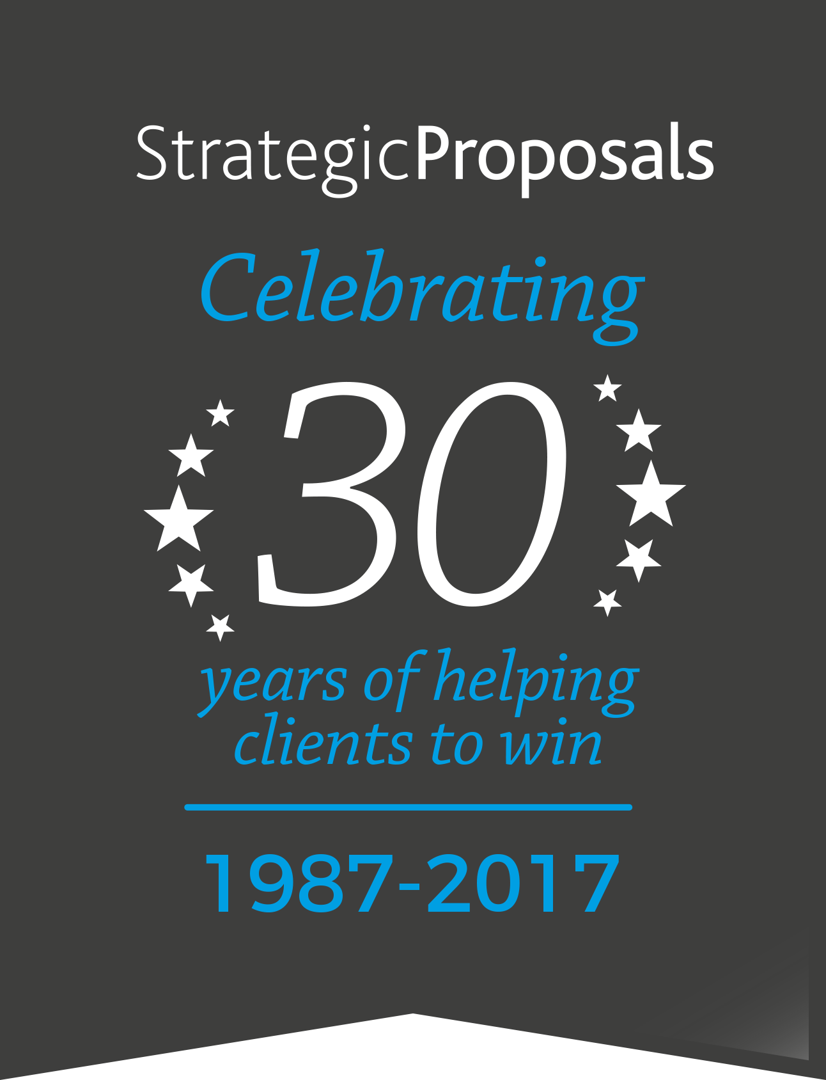
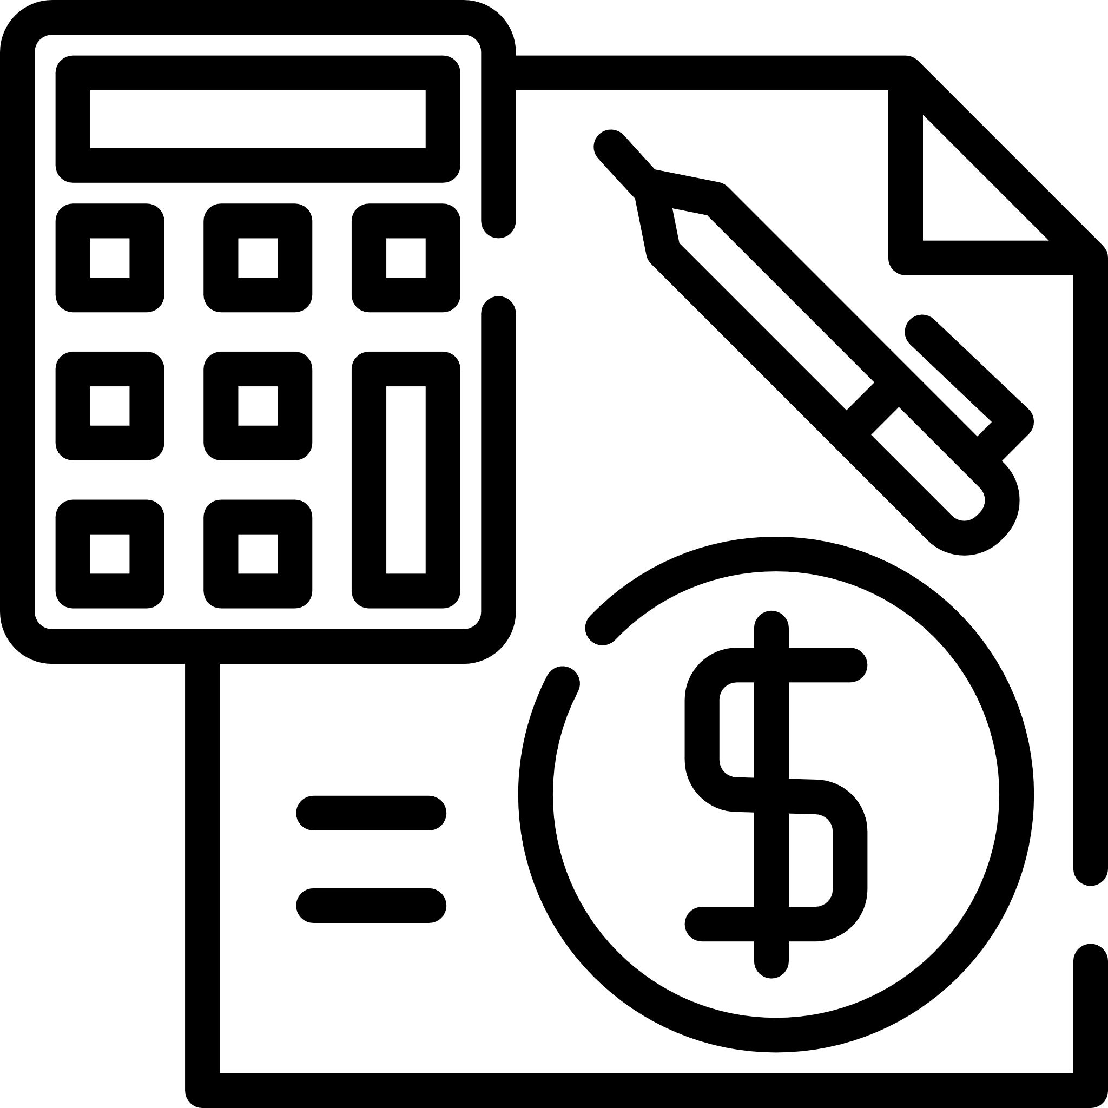
SP benchmarking model
42 criteria
60+ pages
Notes:
Strategic Proposals has long helped organisations to assess their proposal capabilities using a detailed proposal benchmarking model. In 2017, as part of our 30th anniversary celebrations, we decided to put highlights of this online, free, for all to use.

Slide 3
Proposal BenchmarkerTM
Click here
Notes:
The Proposal Benchmarker tool allows proposal organisations to assess their capabilities online. It takes around 45 minutes to complete, and can be found at www.proposalbenchmarker.com

Slide 4
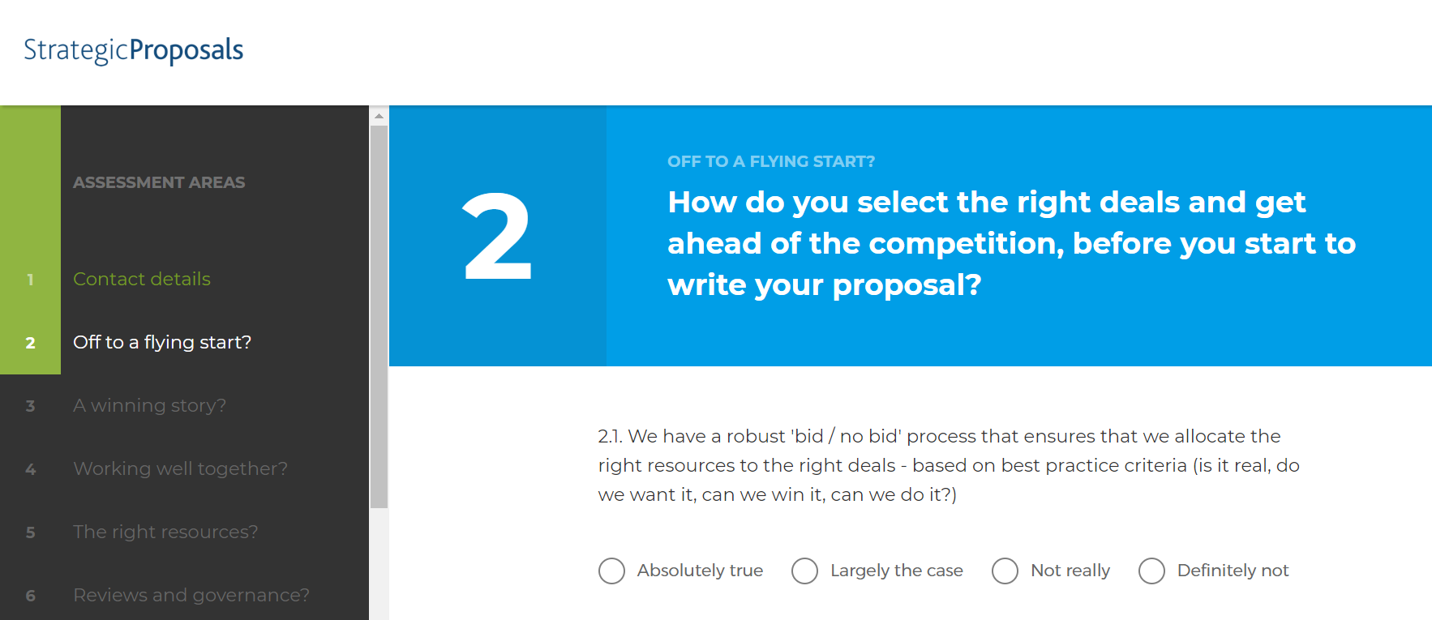
Notes:
To date, nearly 400 organisations have assessed their capabilities using the benchmarking tool. Here’s an example screen.

Slide 5
Widespread good practice
Proposal capability and win rate
Common issues
Notes:
In this presentation, we explore what most proposal teams do well – and the common problems…

Slide 6
Proposal capability versus win rate
The most successful teams
Notes:
We look at the link between proposal capabilities and win rates…

Slide 7
The most successful teams
Notes:
…and we explore what differentiates the most successful organisations from the masses when it comes to proposal development.

Slide 8
Discussion topic
One thing you’re proud of regarding your proposals
Notes:
Before we get going, pause and think: what do you currently do really well? What are you proud of? The Proposal Benchmarker helps companies to celebrate success, as well as identifying opportunities for improvement.

Slide 9
What (almost)
everybody
is doing
well
Notes:
Let’s start by looking at things that most organisations are doing well when it comes to proposals, according to the data from the benchmarking tool.

Slide 10
P
80%
doing well
Notes:
What do 80%+ of respondents have covered?

Slide 11
88%
All proposal content is approved before it’s issued
80%
We rarely struggle to deliver what we’d promised in the proposal
Notes:
Governance seems to be sorted!

Slide 12
P
P
Experienced proposal staff
Helping to win business
70%
doing well
Notes:
Over 70% have experienced people supporting their proposals, and are helping to win business via the documents they submit – and hence to create and protect jobs in their organisation.

Slide 13
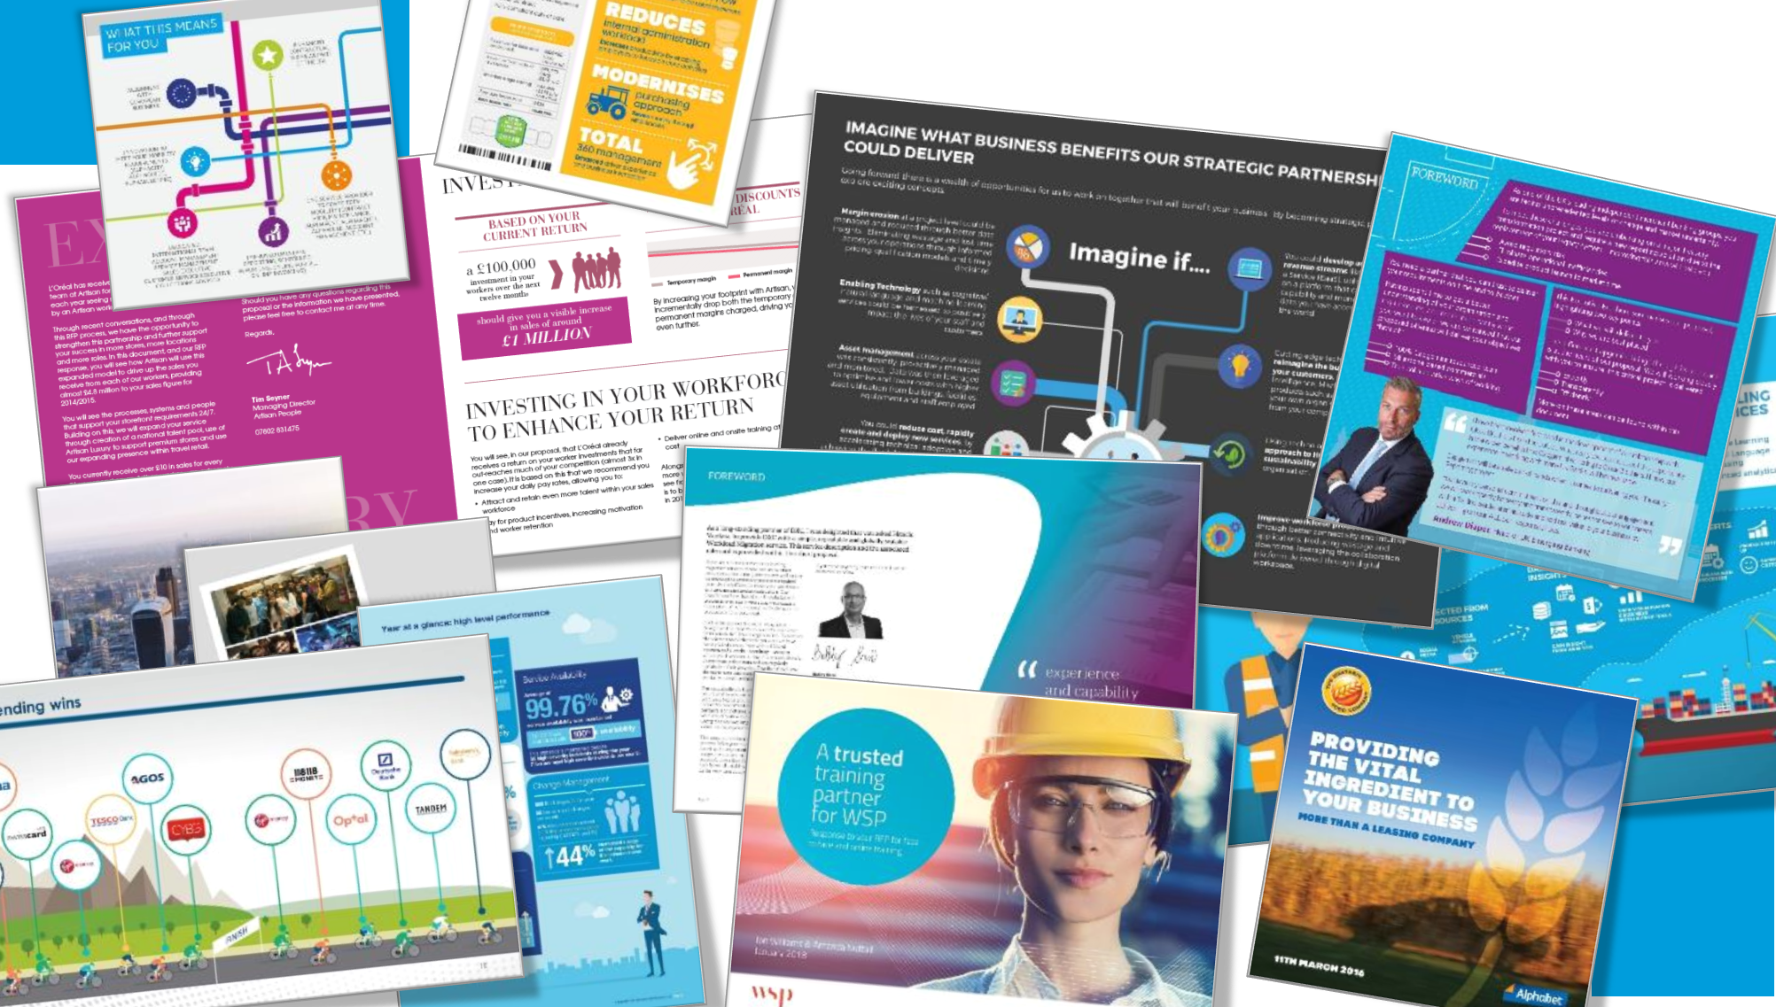
Proposal output
Notes:
More than 70% also believe that they produce good output – well-written and designed. (Here are a few examples of content developed by the Strategic Proposals team over the past couple of years!)

Slide 14
The pitch
Notes:
More than 70% also believe they have sound processes for bringing the written proposal to life effectively in the bid / proposal presentation (or ‘pitch’).

Slide 15
2/3
P
doing well
Notes:
And there’s a series of things that more than 2/3rds of people thing they’re doing well…

Slide 16
Prioritised support
Notes:
1) Having a clear model in place showing what support the proposal organisation will provide for each deal, prioritised according to e.g. the strategic importance or value of the bid

Slide 17
Kick-off workshop
Notes:
2) Running a great kick-off workshop at the start of the bid / proposal, to get team members connected and motivated

Slide 18
Executive engagement
Notes:
3) Being able to engage senior execs as required to help with specific bids

Slide 19
Avoid internal bureaucracy
Notes:
4) Having processes that don’t drag the bid team down with excessive internal admin or bureaucracy (as they try, for example, to fill in paperwork or follow the internal governance process)

Slide 20
The death of ‘death by PowerPoint’
Notes:
5) Producing bid/proposal presentations that feel contemporary

Slide 21
If you’re not doing these things well, you’re falling behind.
Notes:
Given all the areas discussed so far are topics where the clear majority of organisations are doing well – if you’re not doing any of them, you’re losing advantage to your competitors. Urgent action needed!

Slide 22
Discussion topic
One thing you struggle with, proposal-wise
Notes:
Let’s start to look at where teams struggle!

Slide 23
Areas of weakness
> 70%
Reactive approach
Inward focus
Notes:
Over 70% of respondents:
report a reactive approach – typically engaging after the customer’s RFx has landed, rather than working on proactive / renewal proposals or consistet adopting a robust approach to pre-proposal planning
are inwardly focused: that is, they haven’t recently conducted any external benchmarking (prior to completing the Proposal Benchmarker) and don’t regularly run client audits to get feedback on the quality of their proposals versus competitors’.

Slide 24
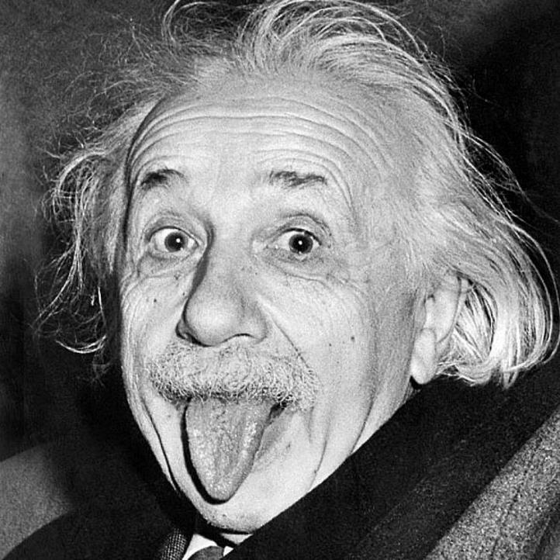
“The definition of insanity is doing something over and over again and expecting a different result.”
Image: knowyoumeme.com
Notes:
…and if you’re not continually, actively seeking to improve, then that naturally brings risks!

Slide 25
Impact
on win
rate
Notes:
So, how do proposal capabilities influence win rates?

Slide 26
People buy from people they know, like and trust.
Notes:
Of course, the proposal is only part of the overall campaign, and relationships with the client are key.

Slide 27
Proposal staff can’t be measured on win rate alone
Notes:
Written proposals (and pitches) contribute to winning (or losing) a deal, but there’s a huge amount else going on during the bid that’s outside the control of the proposal team. Any balanced scorecard measuring proposal centres has to recognise this.

Slide 28
Win
1
P
score
Win more
2
Win more than your fair share
+
Notes:
In the Proposal Benchmarker, we ask two questions about success (rather than asking people to state their win rate – which many wouldn’t do, and which can be measured in very different ways by different organisations). We add up the scores they give to two questions (“do you win more than you lose” and “do you win more than your fair share given your position in the market”) to give a “win score”.

Slide 29
Proposal
capability
Win score versus 96 other answers
Notes:
…and then we add up their total score on the 96 other questions.

Slide 30
100%
90%
80%
Option 3
70%
60%
Option 2
Win score
50%
40%
30%
Option 4
20%
10%
Option 1
0%
<40%
41% - 59%
60% - 74%
75%+
Capability score
Notes:
What do you think the graph looks like when we plot the win score against the total score for the 96 capability questions?

Slide 31
<40%
Ad-hoc
capability score
sales produce proposals
“buddies and favours”
debatable quality
15%
of organisations
Notes:
Here’s what the bottom tier of respondents looks like.

Slide 32
100%
90%
80%
70%
60%
Win score
50%
40%
30%
20%
10%
Ad-hoc
0%
<40%
Capability score
Notes:
…and here’s their average win score.

Slide 33
41-59%
Tactical
capability score
proposal support factory
“make life easier”
responding to RFPs
chasing everything
insufficient resources
62%
of organisations
Notes:
The next tier – comprising the majority of organisations…

Slide 34
100%
90%
80%
70%
60%
Win score
50%
40%
30%
20%
10%
Ad-hoc
Tactical
0%
<40%
41% - 59%
Capability score
Notes:
…and their win score increases.

Slide 35
Strategic
60-74%
capability score
established proposal support function
clearly defined processes
qualification process exists
library of content (albeit sometimes out-of-date)
18%
of organisations
Notes:
The organisations who seem to ‘get it’….

Slide 36
100%
90%
80%
70%
60%
Win score
50%
40%
30%
20%
Strategic
10%
Ad-hoc
Tactical
0%
<40%
41% - 59%
60% - 74%
Capability score
Notes:
…and their win score again increases.

Slide 37
Notes:
But still, at this stage of proposal maturity, it can feel as it the proposal centre is battling against the odds. Processes exist, tools are in place – but it’s a continual battle to gain full buy-in, and to secure investment in developing proposal capabilities.

Slide 38
Strategic+
75%+
capability score
in the DNA
highly proactive
ruthless qualification
investment to be the best
exceptional output
5%
of organisations
Notes:
But the model shows the emergence of a real top tier: “Strategic+”, as we’ve termed it – where proposal development really is in the DNA of the business.

Slide 39
100%
90%
80%
70%
60%
Win score
50%
40%
30%
20%
Strategic
Strategic +
10%
Ad-hoc
Tactical
0%
<40%
41% - 59%
60% - 74%
75%+
Capability score
Notes:
…and the graph is quite remarkable: as you improve your capabilities, your win score goes up. There’s pretty much a straight line, direct correlation.

Slide 40
It’s a simple formula:
Improve proposal capabilities =
win more business
Notes:
Although there are other factors at play, the data shows clearly that improving proposal capabilities does have a huge impact on your chances of winning.

Slide 41
Where are you on the scale?
Ad-hoc
Tactical
Strategic
Strategic+
Notes:
So, which of the four camps do you think you fall into?

Slide 42
Strategic+
The emergence
of a true top tier
Notes:
The Proposal Benchmarker really has identified that there’s a top tier of proposal support organisations, soaring above the masses.

Slide 43
How
the
best
succeed
Notes:
Let’s look at how the most successful organisations in the database compare to the rest…

Slide 44
Top tier
vs
Masses
Notes:
…looking at answers which have statistically significantly higher scores for the top tier compared to the majority…

Slide 45
Truly robust qualification
Pre-proposal planning
Early
senior reviews
High skilled
peer reviewers
Process excellence
Notes:
The best teams engage early, with a truly robust end-to-end process.

Slide 46
Leadership not
merely managing
Excellent
kick-off
Active senior
executives
Confidence, cohesion,
creativity, control, calm,
clear communication
Proposals:
‘the place to be’
Avoid ‘late nights,
cold pizza’
Strong proposal leadership
Notes:
Their proposal staff lead teams, rather than merely managing them.

Slide 47
Joy to read
Looking great
Highly bespoke / custom
Excellent client feedback
Creative presentations
Competitive advantage
Exceptional deliverables
Notes:
“Good enough” isn’t good enough – they’re focused on producing truly excellent output at every stage…

Slide 48
Senior leadership
Priority support models
Robust capacity plan
Strong external focus
Regular training for all
Pipeline
confidence
In your business’s DNA
Notes:
…and this is all championed from the top down, with everyone involved trained in the necessary skills.

Slide 49
What would your CEO say?
Notes:
As a test, what would your CEO say about your proposals? Would s/he be actively engaged in supporting and championing your cause – or have no idea of the challenges you face?

Slide 50
how
well do
you stack
up…
Notes:
The challenge from this presentation: to assess how well you stack up, compared to other organisations!

Slide 51
Questions?
Notes:
Time for discussion?

Slide 52
Proposal BenchmarkerTM
Click here
www.proposalbenchmarker.com
Notes:
Do have a go with the tool yourself? (We’ll even send a free report summarising your scores, and some recommendations – one per organisation!)

Slide 53
Thank you!
Jon Williams
+44 (0)781 333 2294
jw@strategicproposals.com
StrategicProposals.com
ProposalBenchmarker.com
ProposalGuys.com
@ProposalsSP
Notes:
And stay in touch! We hope you’ve enjoyed the presentation and found it useful.

